Slide 1

Efficient Serverless Function Scheduling at the Network Edge
Team Members:
P. Maakhish Sai B221135CS
S. Mohith Sri Vaishnav B221224CS
M.Krishna Harsha B220042CS

Slide 2
Problem Statement
The core problem is the Serverless Function Scheduling(SFS) problem in resource-limited edge computing, with the aim to minimize the average response time.
This challenge is driven by two main issues:
Significant Cold Start Latency: Edge servers have limited resources, leading to frequent function replacement and subsequent cold starts, which cause major delays.
Request Blocking: The highly dynamic nature of edge workloads causes short, quick requests to be blocked (held in queue) behind longer-running function requests which increases the average waiting time for all the users.

Slide 3
Edge Computing:
Form of distributed computing, computation as close as possible to the source of data, rather than solely relying on a cloud infrastructure.
Reduces Latency, and Improves Responsiveness and also Reduces Bandwidth.
Serverless Computing:
A cloud computing model that allows developers to build and run the applications without having them to manage the underlying servers or the infrastructure.
The cloud provider will automatically provision, scale and manage those resources as needed or depending on conditions provided by the developer etc.
Different from FaaS (Function as a Service).

Slide 4
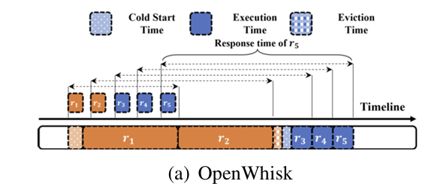
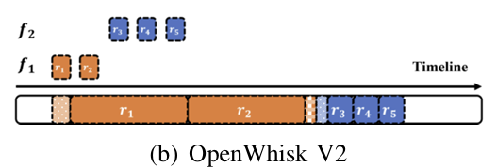
Existing Methodologies
OpenWhisk V1
OpenWhisk V2
A centralized scheduling strategy that processes incoming serverless function requests in the order of their arrival—a classic first-come, first-served model.
It is designed to separate the control flow and data flow. By decoupling these flows, OpenWhisk V2 can maintain individual queues for each function.
Images Adapted from Zhang et al., 2024 (arXiv:2405.12345)
Notes:
The above techniques cannot properly resolve the severe problems of function instance over-provision and frequent cold starts.
Optimise RESPONSE TIME of Serverless Requests

Slide 5

Limitations
OpenWhisk V1
Uses a centralized global queue and schedules functions strictly in arrival order (FCFS).
Triggers frequent cold starts because it initializes new instances whenever no idle instance is available.
Not designed for resource-limited edge environments.
OpenWhisk V2
Maintains separate queues per function, improving isolation.
However, blocking still occurs if many requests of one function arrive continuously.
Does not evaluate whether replacing one function with another would reduce the total response time.

Slide 6
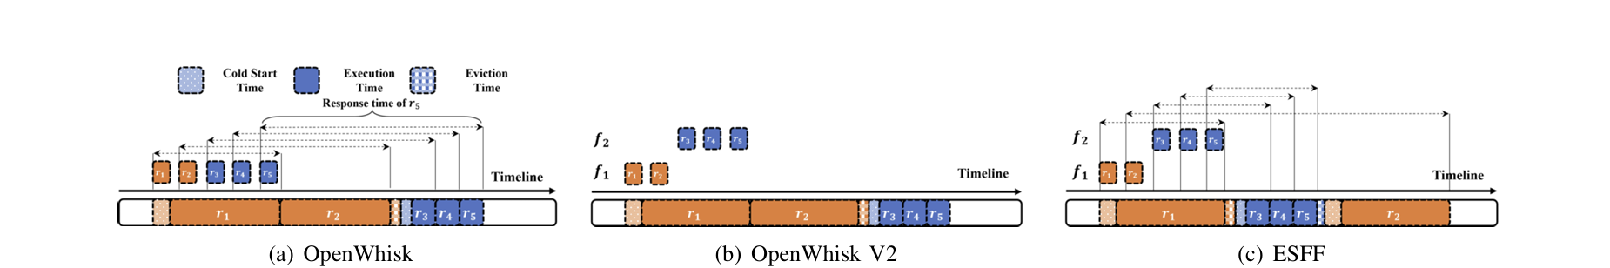
Motivation
ESFF
Dynamically compares function urgency (weights).
Switches to f₂ after r₁ → short requests served immediately.
Minimizes blocking and cold-start overheadead.
Image Adapted from Zhang et al., 2024 (arXiv:2405.12345)

Slide 7

Problem Statement
SFS Problem
Each request rᵢ has arrival time (tₐᵢ), execution time (tₑᵢ), and belongs to function fⱼ.
Before running, an instance of fⱼ must be initialized → cold start latency; evicting an instance adds eviction time.
Requests must run to completion (no preemption).
Edge Server Constraints
Server can hold at most C function instances at once.
Each instance processes one request, idle instances may be evicted when capacity is full.
Objective
Minimize average response time: T = (1/|R|) ∑ (tᶜᵢ − tᵃᵢ)
Proved to be NP-Hard

Slide 8
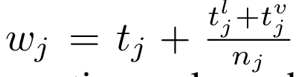
Simplified SSFS Problem (OSSFS)
Simplifying Assumptions
Unary server: Only one function instance can exist at any time (capacity = 1).
All requests arrive at time 0: No dynamic arrivals → no online uncertainty.
Same-function requests have identical execution time: Every request of function fⱼ takes same time tⱼ.
Cold start and eviction times are known: tₗⱼ = cold start time, tᵥⱼ = eviction time.
Goal of SSFS
Determine the optimal order of functions to minimize total response time. (OSSFS)
Why SSFS Matters
This simplified model reveals that functions should be scheduled by a weight.
Processing functions in ascending order of weight gives the optimal SSFS schedule.
Image Adapted from Zhang et al., 2024 (arXiv:2405.12345)
Notes:
All information is known before scheduling → pure offline scheduling.
Meaning:
Lower weight → more urgent
Schedule functions in ascending order of weight.

Slide 9

ESFF
A lightweight online scheduling algorithm designed for resource-limited edge servers. Extends the optimal weight-based idea from SSFS to the real SFS problem.
1. Function Creation Policy (FCP)
Invoked when a new request arrives.
Decides whether to initialize a new instance of that function.
Avoids unnecessary cold starts by checking if creating a new instance will actually reduce response time.
2. Function Replacement Policy (FRP)
Invoked when a request finishes.
Compares function weights to decide whether to replace the current function instance with a more urgent one.
Prevents short requests from being blocked by long ones.

Slide 10
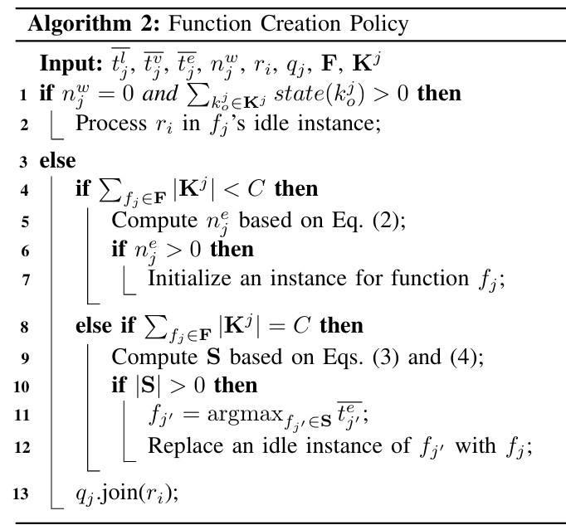
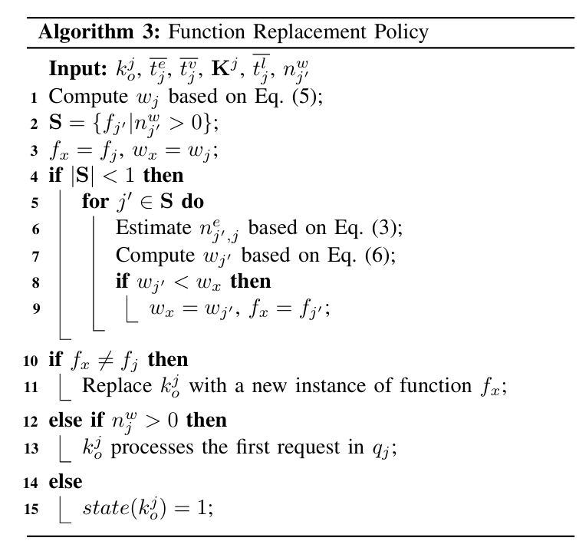
ALGORITHMS
Images Adapted from Zhang et al., 2024 (arXiv:2405.12345)

Slide 11
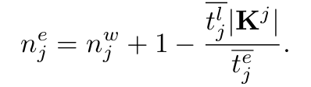
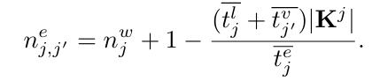
Function Creation Policy (FCP)
Purpose
Decides whether to create a new function instance when a request arrives.
Prevents unnecessary cold starts on a resource-limited edge server.
How FCP Works
If an idle instance already exists, run the request immediately.
Otherwise, estimate if creating a new instance is beneficial.
If nᵉ > 0 → Creating a new instance will reduce response time → initialize instance.
If nᵉ ≤ 0 → New instance won’t help → queue the request.
Images Adapted from Zhang et al., 2024 (arXiv:2405.12345)
Notes:
Intuition
FCP only initializes when at least one request will be served efficiently.
This avoids wasteful cold starts during bursts and saves limited server capacity.

Slide 12

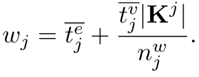
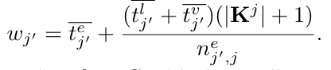
Function Replacement Policy (FRP)
Purpose
Determines whether to replace a function instance after it finishes executing a request.
Ensures urgent (short) functions are not blocked by long-running ones
How FRP Works
Triggered when a request completes.
Computes the function's weight (urgency) using this formula
Looks for another function that has:
waiting requests, and
lower weight (more urgent).
If such a function exists → replace the current instance with that function.
Otherwise → reuse the instance for its own waiting queue.
Images Adapted from Zhang et al., 2024 (arXiv:2405.12345)
Notes:
Intuition
FRP shifts the server to the most urgent function at each completion event.
Prevents short requests from being stuck behind long functions.
Reduces blocking and improves overall response time.

Slide 13
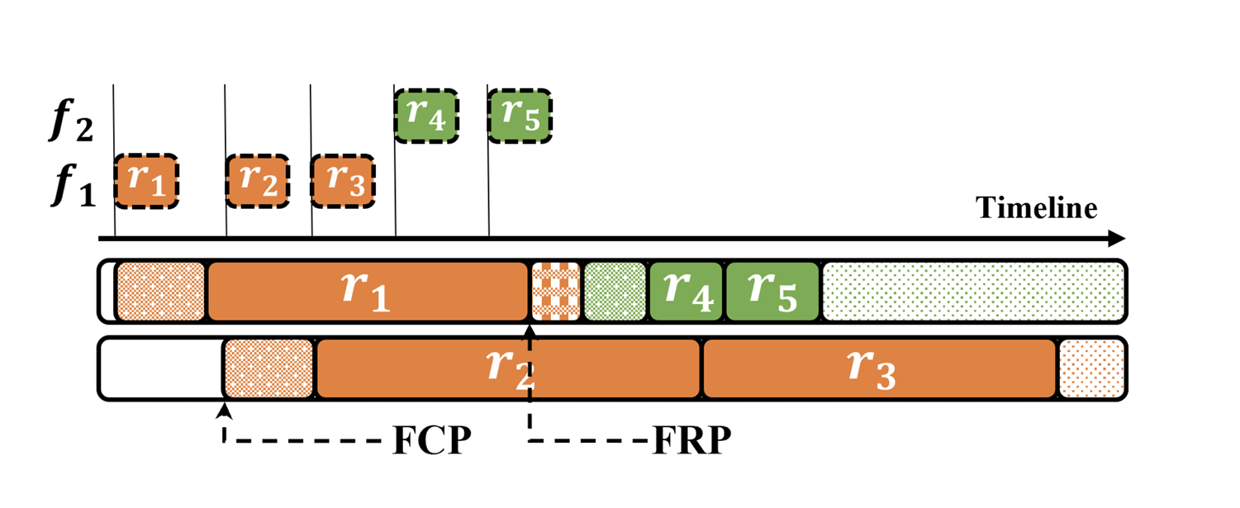
Example of ESFF
Images Adapted from Zhang et al., 2024 (arXiv:2405.12345)

Slide 14
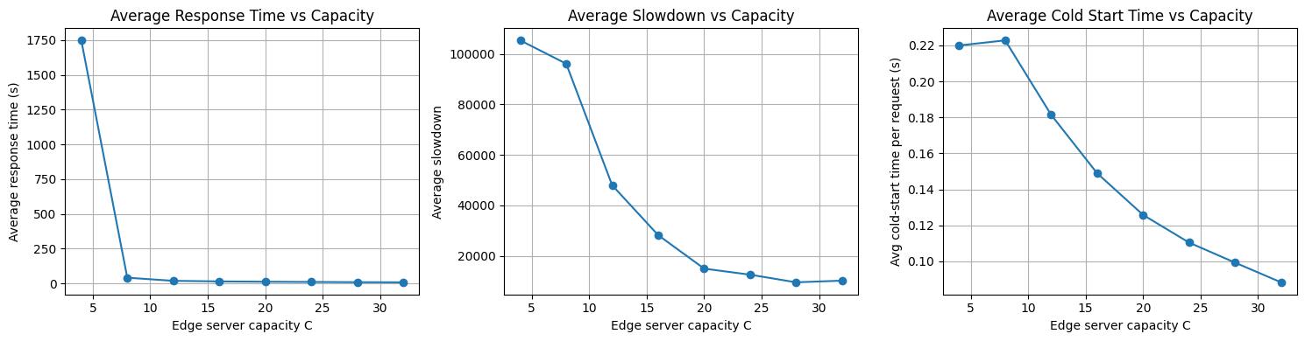
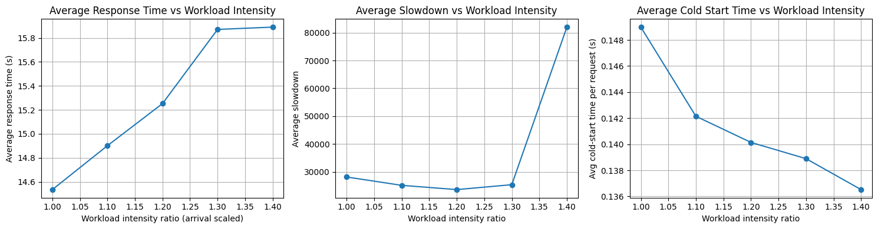
Results

Slide 15
THANK YOU

